Slide 1

Mental Health in
the Tech Field
By Nina Rice

Slide 2
Questions
The aim of my investigation:
Which workplace factors seem to have the strongest relationship with mental health among employees in the tech industry?
What are the negative implications on one’s career when dealing with mental health conditions?

Slide 3
Background
Why do I care?
Having studied Clinical Psychology in undergrad, I’m interested in the role that mental health has on the wellbeing of our world.
It’s important that we can sustainably make our mental wellbeing a daily priority.
This may affect us in our future careers!

Slide 4
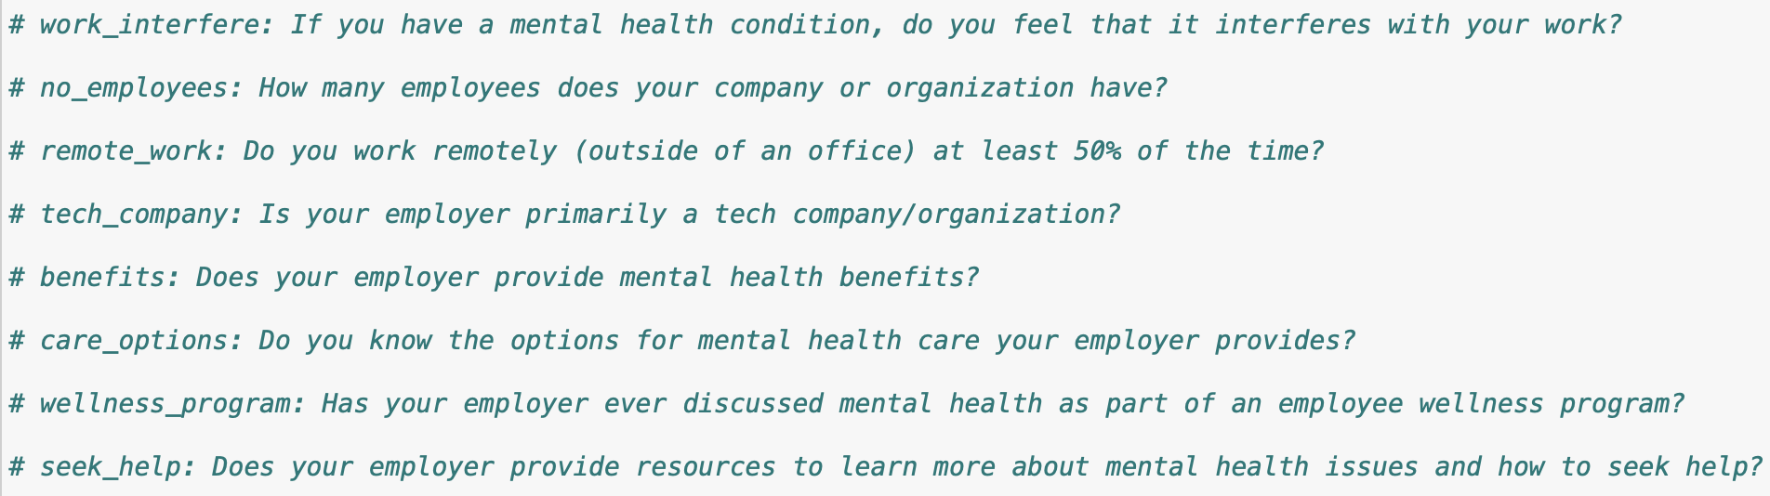
Data
Survey data collected by Open Sourcing Mental Health in 2014 https://www.kaggle.com/datasets/osmi/mental-health-in-tech-survey
Measures attitudes towards mental health and frequency of mental health conditions in the tech workplace (n = 1259)
Example items

Slide 5
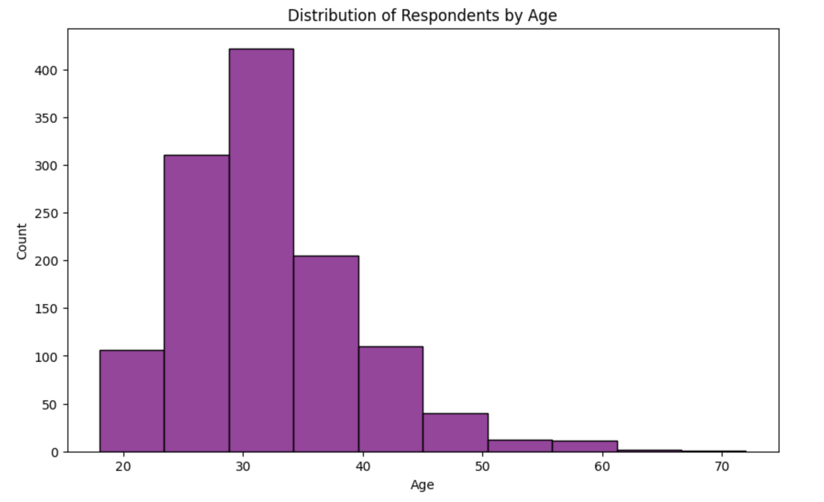
Data

Slide 6
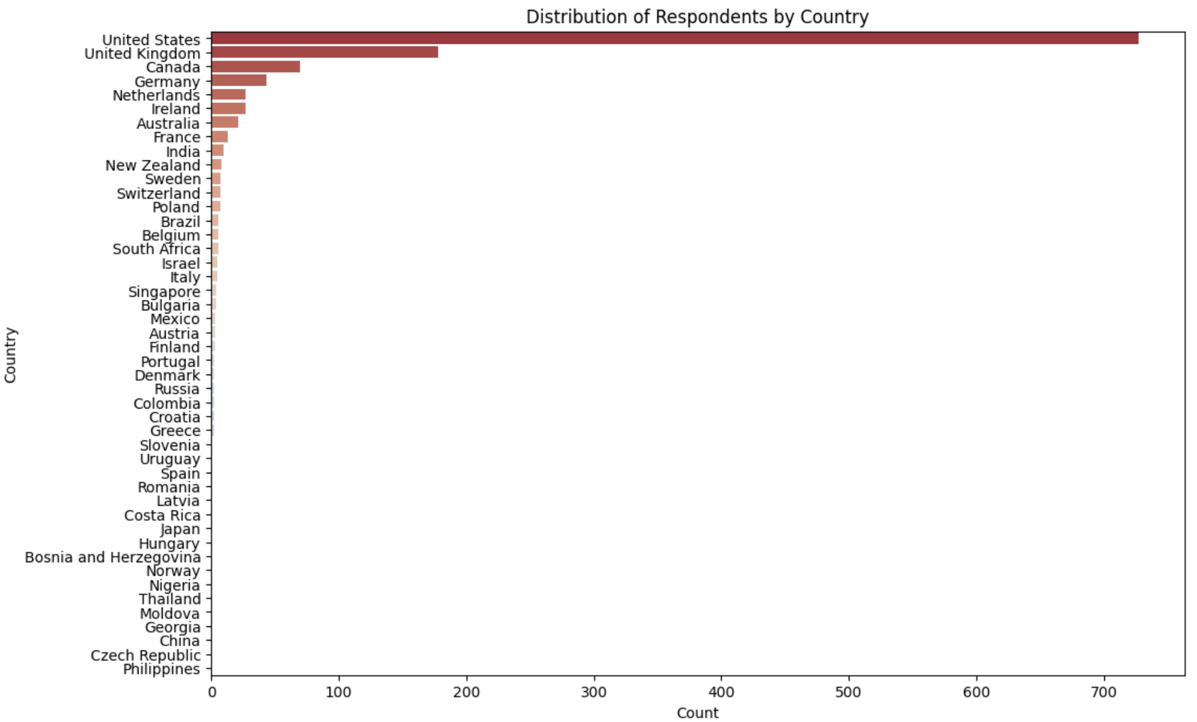
Data

Slide 7
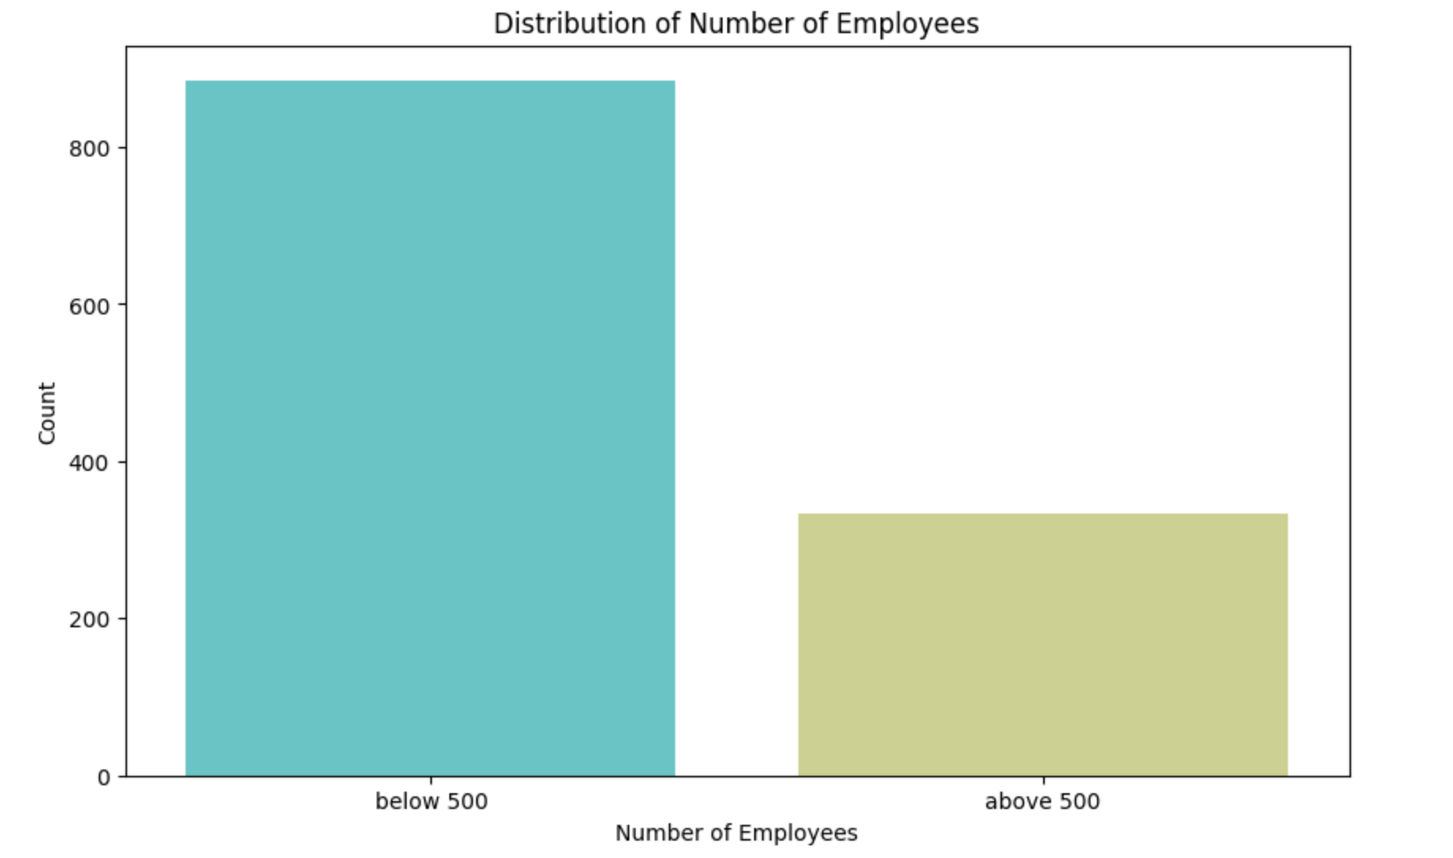
Data

Slide 8
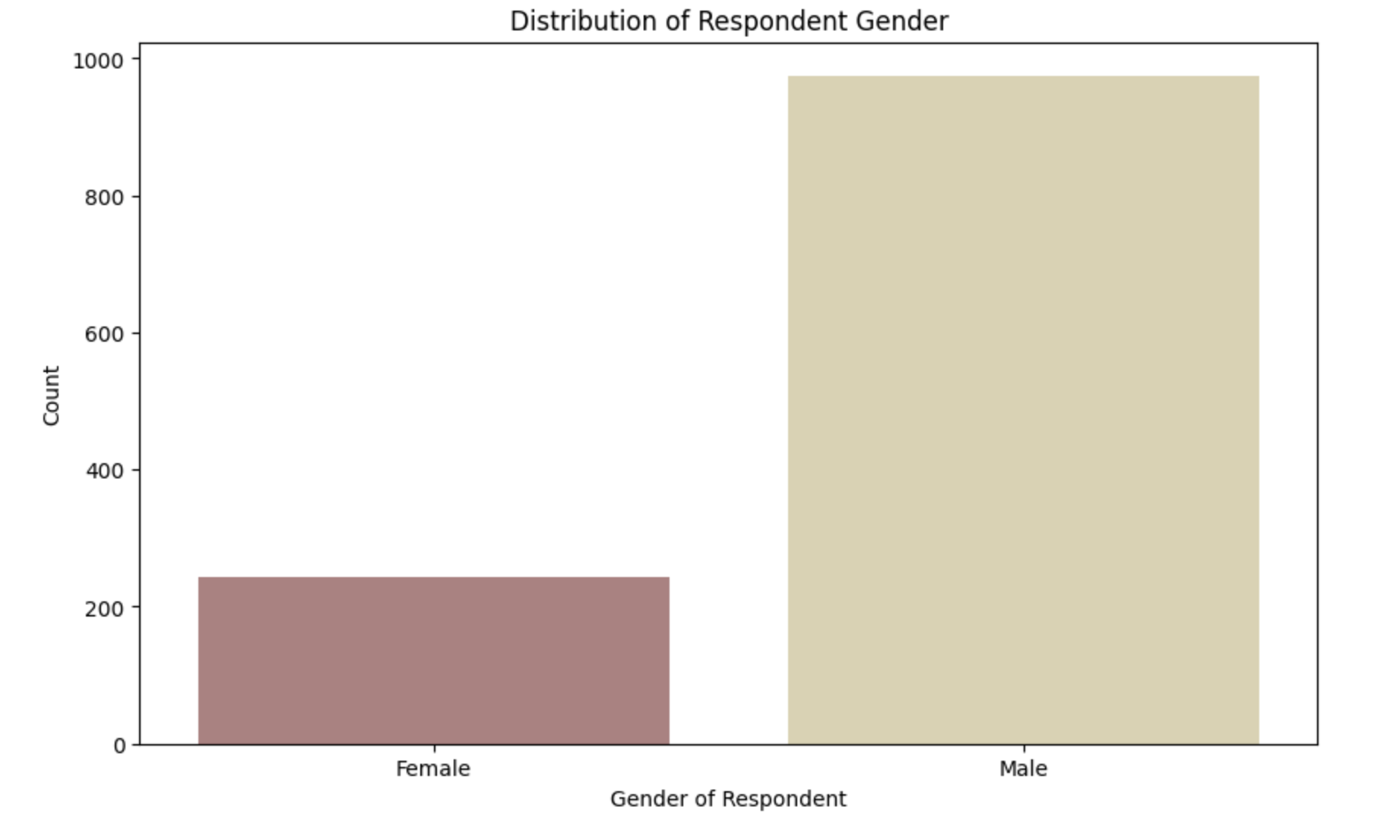
Data

Slide 9
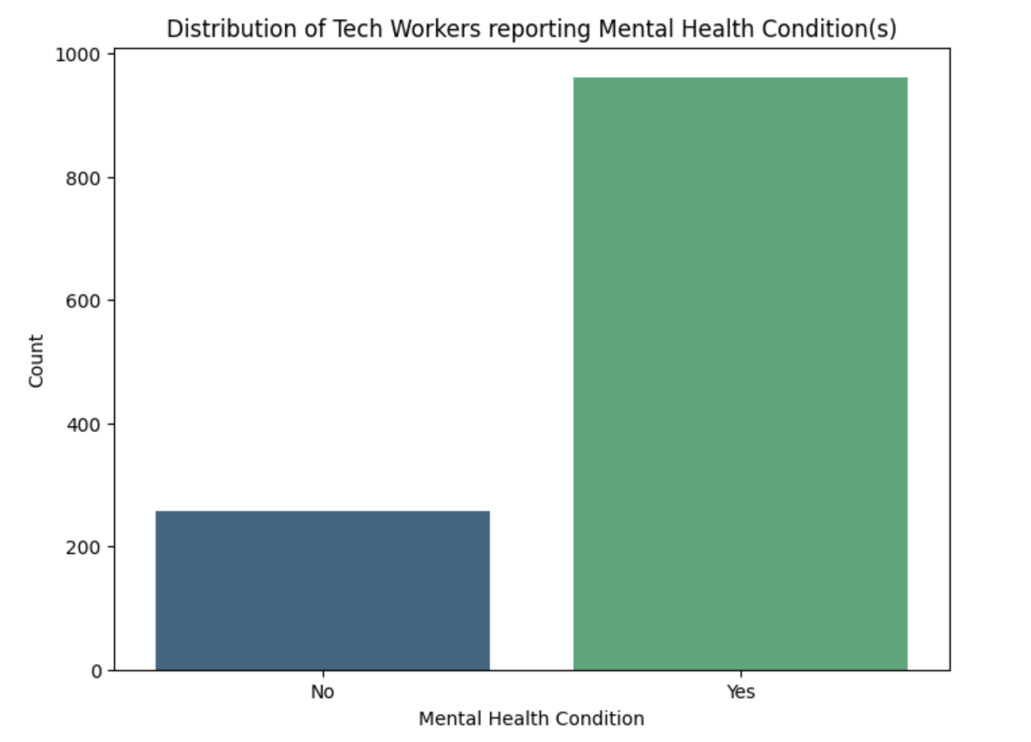
Data

Slide 10
Process
Two logistic regressions: Presence of mental health condition (mh_cond) & Observance of negative consequences for those with mental health conditions in workplace (obs_consequence)
Independent variables included: Family history, Treatment status, Remote work status, Type of company, Option to take MH leave, Availability of wellness program, Willingness to disclose MH during interview, Knowledge of care options available, Availability of MH related benefits, Employer provided resources

Slide 11
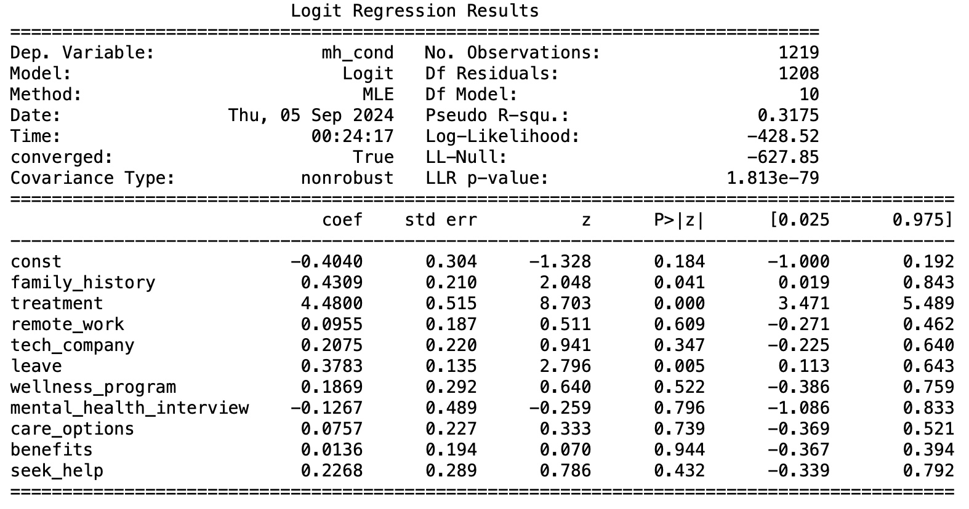
Results
Dependent variable: mental health condition

Slide 12
Results
Dependent variable: mental health condition
Family History (Coefficient = 0.431, P = 0.041)
Having a family history of mental health conditions correlates with increased likelihood of having a mental health condition.
Leave (Coefficient = 0.378, P = 0.005)
Taking leave for mental health conditions is correlated with having a mental health condition.
Wellness Program (Coefficient = 0.187, P = 0.005)
Having a wellness program correlates with the likelihood of employees’ having mental health conditions.
Insignificant correlations
Remote work, Type of company, Availability of wellness programs, Willingness to disclose MH during interview, Knowledge of care options, Availability of MH related benefits, Employer provided resources

Slide 13
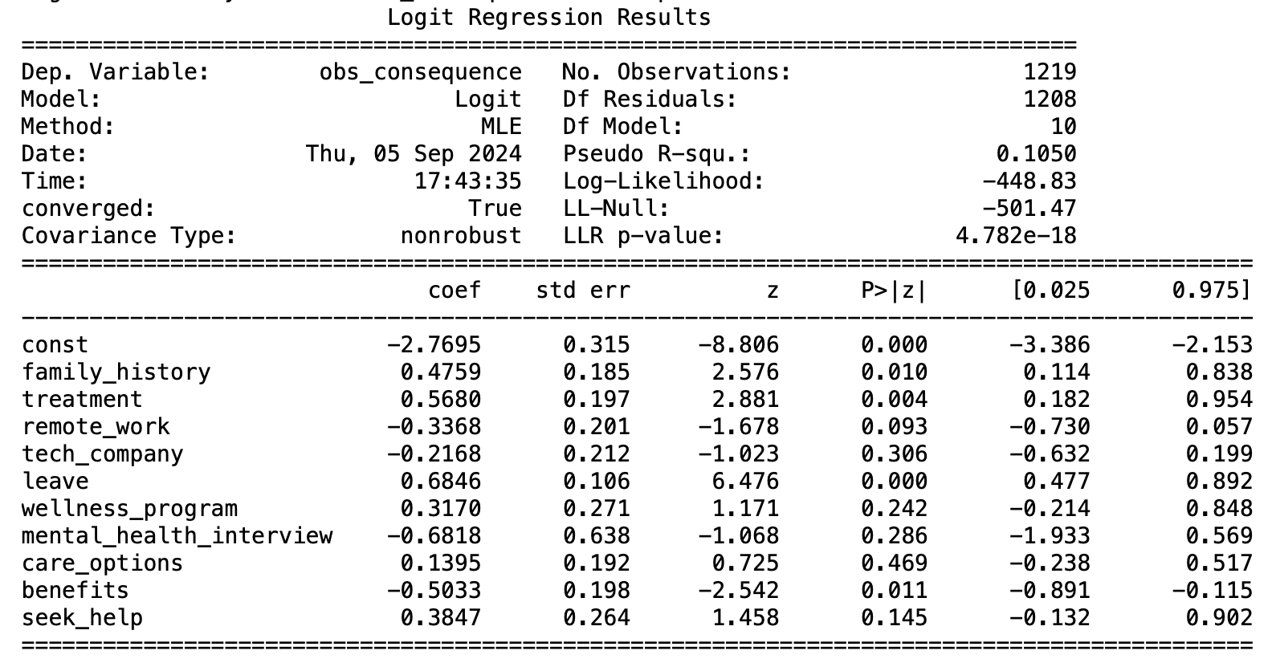
Results
Dependent variable: observance of negative consequences

Slide 14
Results
Dependent variable: observance of negative consequences
Family History (Coefficient = 0.476, P = 0.010)
Having a family history of mental health conditions correlates with a person observing consequences for mental health conditions within their workplace.
Treatment (Coefficient = 0.568, P = 0.004)
Receiving treatment for mental health conditions significantly correlates with the likelihood of a person observing consequences for mental health conditions within their workplace.
Leave (Coefficient = 0.685, P < 0.001)
Taking mental health leave is strongly associated with an increased likelihood of a person observing consequences for mental health conditions within their workplace, and this effect is highly statistically significant.
Benefits (Coefficient = -0.503, P = 0.011)
Availability of benefits is negatively correlated with the likelihood of a person observing consequences for mental health conditions within their workplace, and this effect is statistically significant.

Slide 15
Results
Dependent variable: observance of negative consequences
Insignificant correlations
Remote work, Type of company, Availability of wellness programs, Willingness to disclose MH during interview, Knowledge of care options, Employer provided resources

Slide 16
Conclusions
Workplaces with non-supportive leave policies and insufficient mental health benefits are more likely to exhibit negative consequences for employees dealing with mental health issues.
There are mixed interactions between employees’ mental health status and workplace benefits/care options/resources, maybe indicating that this is not typically a high priority for people when choosing a place of work despite their experiences with mental health conditions

Slide 17
Limitations & Future Research
Limited to pre-existing data with underrepresented subgroups
There are other factors involved in mental health and worklife that may have been looked over
Could be beneficial to build a model that demonstrates estimated changes in mental health based on implementation of wellness programs or other factors
More resources, social support, and education

